Slide 1
Analyzing the Neighborhoods in London for Starting a Cafe
By: Dimitrios Christodoulou
Date: 4/6/2021

Slide 2
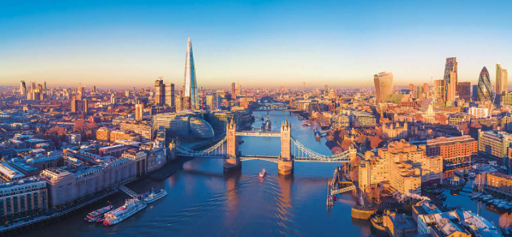
Introduction
London is the capital city of United Kingdom. It is one of the most overcrowded cities in the globe.
There are numerous venues and especially restaurant and coffee shops with many different cuisines.
Business owners and entrepreneurs might be looking to start new café.
The main task to our project is to predict the most suitable location to launch a new café by analyzing and cluster the boroughs.
London, UK

Slide 3
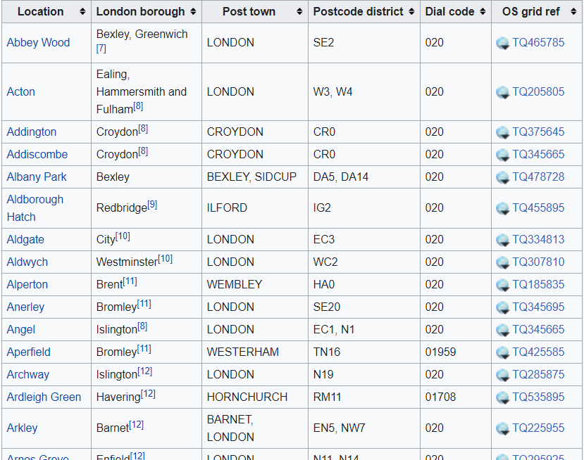
Data Collection
The boroughs data was collected by Wikipedia (East London):
URL: https://en.wikipedia.org/wiki/List_of_areas_of_London.
We use this URL to take the names of
the locations and London's boroughs
and the coordinates of this areas (using
the OS grid ref).

Slide 4
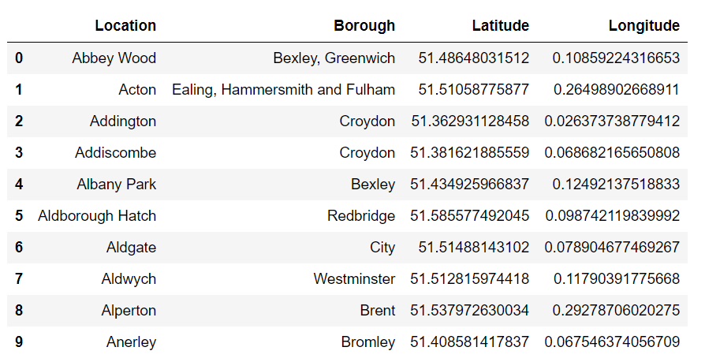
Dataset of the London’s Locations

Slide 5
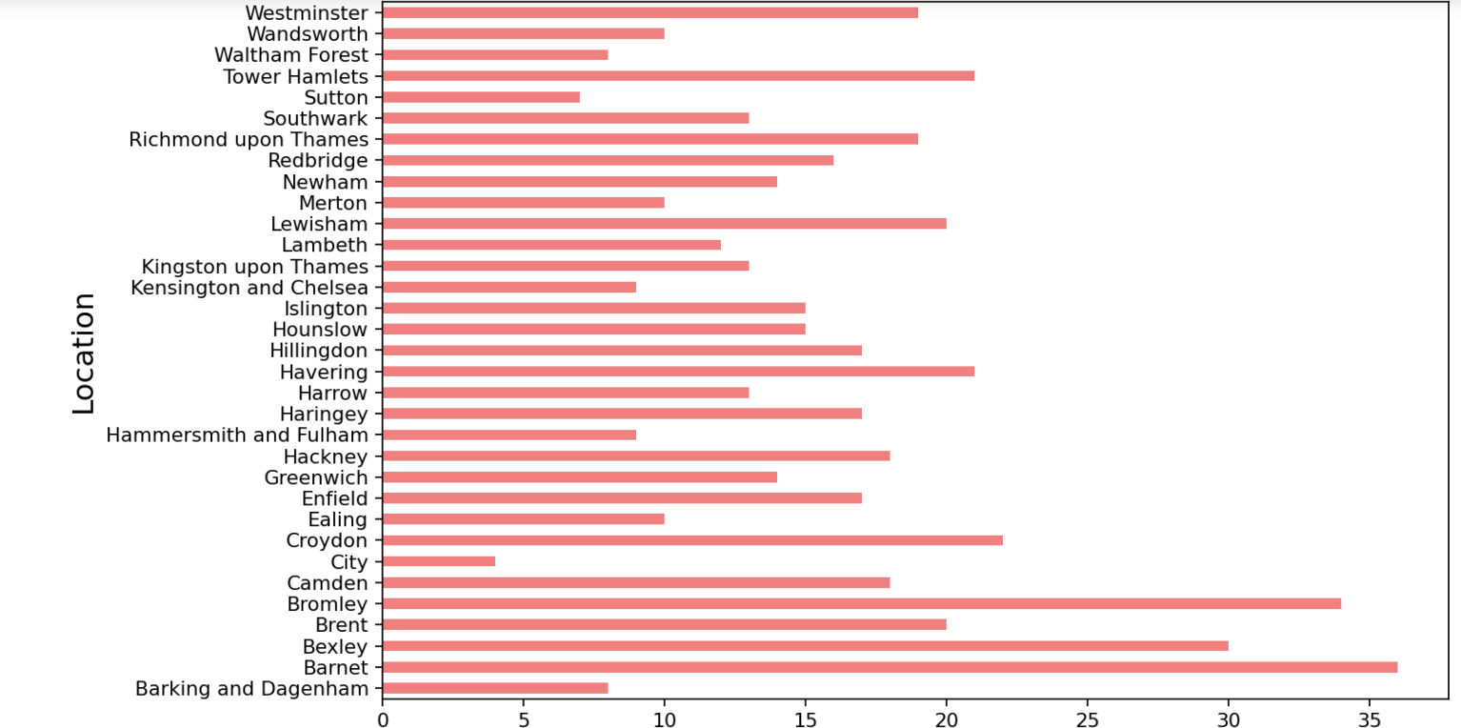
Locations by Borough (Data Visualization)

Slide 6
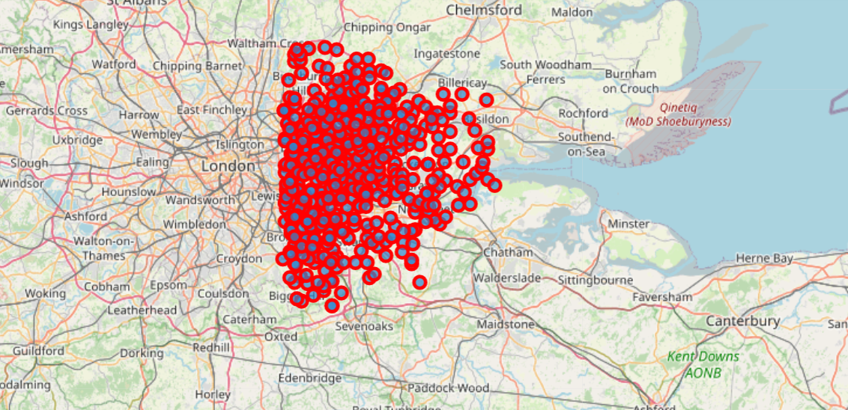
London Location (Map) – Data Visualization
Using the Folium library in python the location of east boroughs to London are visualized.

Slide 7
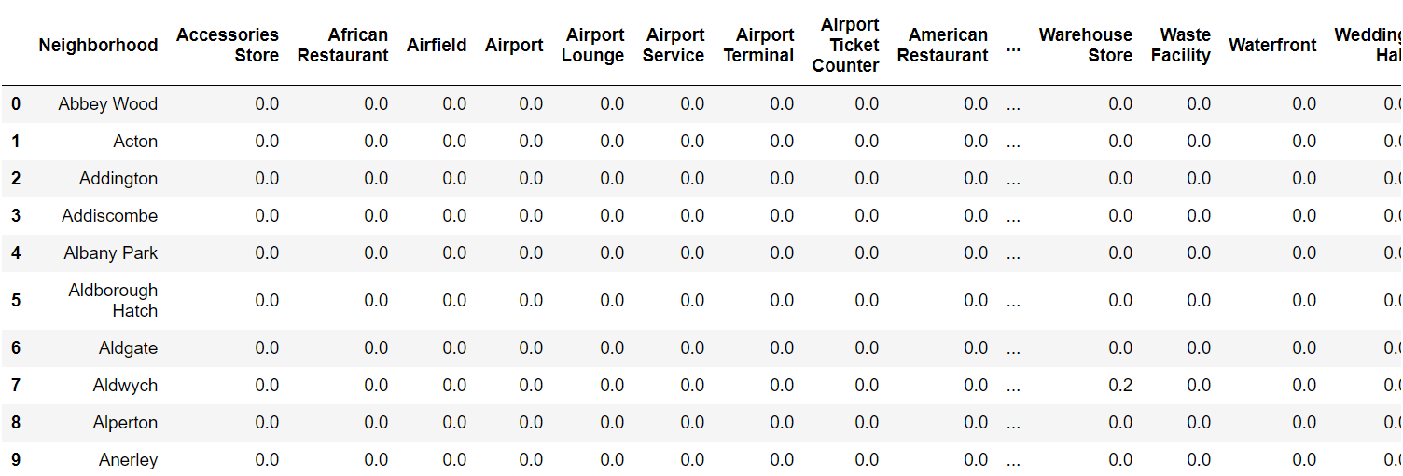
One-hot Encoding
Using One-hot Encoding, the venues categories are encoded with 0 and 1. 1 if a venue belongs to a category and 0 if a venue does not belong to a category.

Slide 8
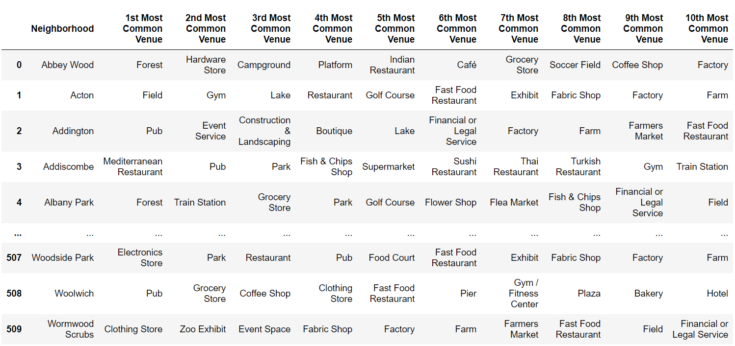
Dataset for Most Common Venues

Slide 9
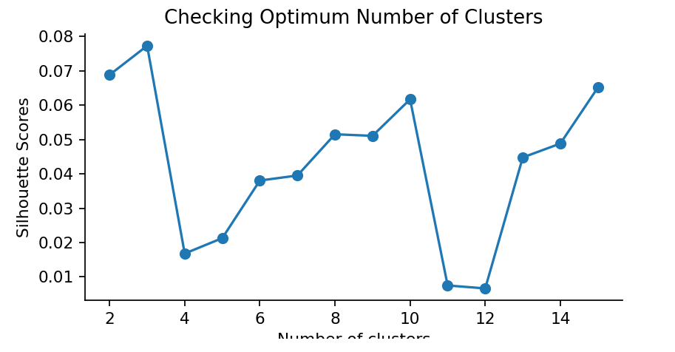
Unsupervised Learning Model
The K-Means was used to cluster the neighborhoods in London.
The next plot give as the maximum value which was (k=3).

Slide 10
Result
Each neighborhood received a cluster label based on clustering by the KMean algorithm.
The Cluster Label column along with the Location, Latitude, and Longitude columns were added to the top 10 most common venues dataframe to provide the final results.

Slide 11
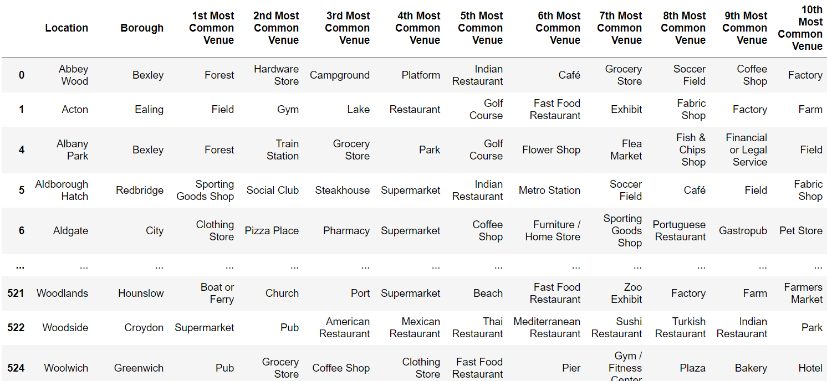
Cluster 1

Slide 12
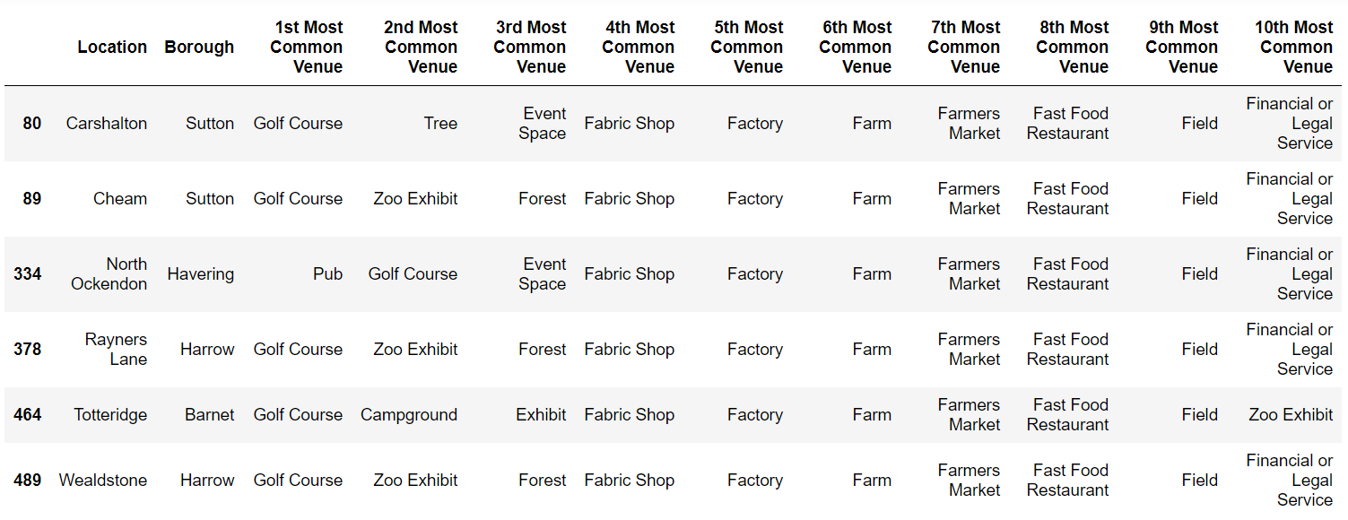
Cluster 2

Slide 13
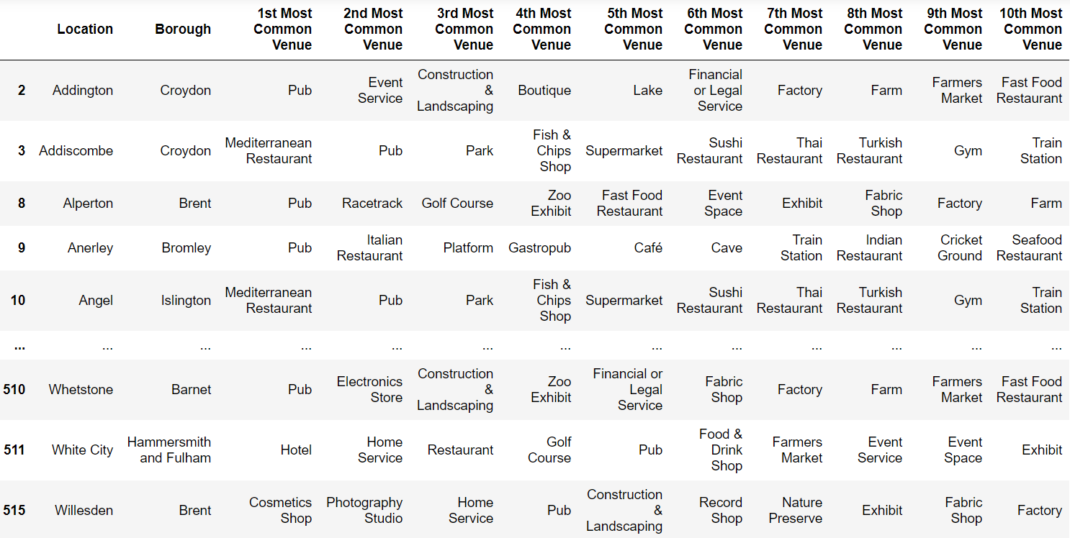
Cluster 3

Slide 14
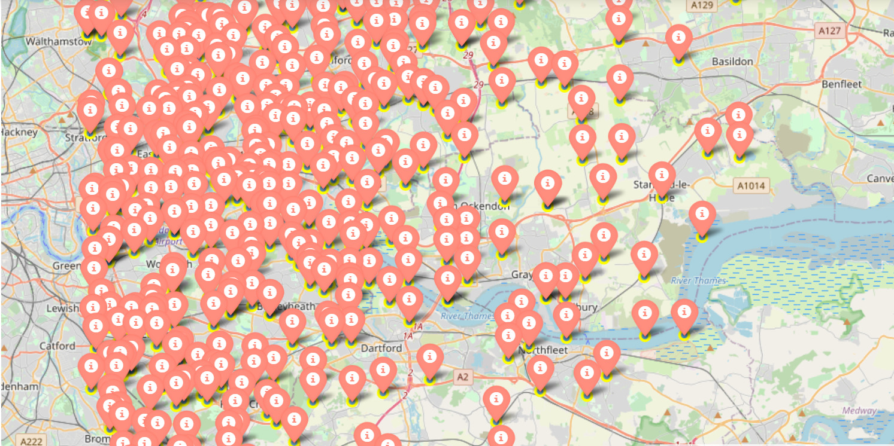
Possible Locations to open a new cafe

Slide 15
Conclusion And Result
Our implementation give to every person the change to find the perfect location to start his new business.
Modifying the input dataset we can take information about various places in the world.
Future Work:
We can use this project to find the preferences of a Borough.

